Slide 1


Employee Data Analysis using Excel
STUDENT NAME : SOWNDARYA T
REGISTER NO : 322200089
DEPARTMENT : B.COM HONOURS
COLLEGE : SHRI SHANKARLAL SUNDARBAI SHASUN JAIN COLLEGE FOR WOMEN

Slide 2


PROJECT TITLE
Employee Performance Analysis using Excel

Slide 3


AGENDA
Problem Statement
Project Overview
End Users
Our Solution and Proposition
Dataset Description
Modelling Approach
Results and Discussion
Conclusion

Slide 4


PROBLEM STATEMENT
The goal of the project is to effectively assess employee performance and identify areas for improvement using Excel.
Generally, A company may struggle to accurately measure and track employee productivity, leading to inconsistencies in performance evaluations and difficulty in making data-driven decisions.
To tackle such problem, we can utilize Microsoft Excel's capabilities to create a comprehensive performance analysis using Excel’s tool that
Collects and organizes relevant employee data (e.g., goals, tasks, deadlines, performance metrics etc.)
Calculates key performance indicators to measure employee effectiveness.
Identifies trends, patterns, and areas of concern within the workforce.
Provides actionable insights for managers to support employee development and overall organizational performance.

Slide 5

PROJECT OVERVIEW
DATA COLLECTION AND MANAGEMENT:
Gathering relevant employee data and information: goals, tasks, deadlines, performance metrics, etc.
Establishing a structured data collection process in order to ensure consistency and accuracy in the analysis
Developing a data management system within Excel for organizing and storing collected information efficiently.
2. KPI DEVELOPMENT AND CALCULATION:
Identifying key performance indicators (KPIs) that align with organizational goals, objectives and employee roles.
Creating formulas and calculations in Excel to accurately measure KPIs.
Customizing KPI calculations based on specific requirements of the company or industry standards.

Slide 6
PROJECT OVERVIEW
3. DATA ANALYSIS AND VISUALIZATION:
Utilizing Excel's analytical functions to identify trends, patterns, and outliers in employee performance data.
Employing visualization techniques (like charts, graphs) in order to present complex data in a clear and understandable manner.
Developing interactive dashboards to provide real-time insights and facilitate data exploration.
4. REPORT GENERATION AND DISTRIBUTION:
Creating standardized performance reports that summarize key findings and recommendations.
Customizing report formats to meet specific stakeholder needs or preferences.
Establishing a distribution process to ensure timely delivery of reports to relevant parties.

Slide 7

PROJECT OVERVIEW
5. TOOL MAINTENANCE AND UPDATES:
Regularly reviewing and updating the Excel tool to incorporate changes in organizational objectives or performance metrics.
Providing ongoing support and training to users to ensure effective tool utilization.
Implementing data security measures to protect sensitive employee information.

Slide 8


WHO ARE THE END USERS?
HR Professionals
Department Managers
Senior Executives
Individual Employees
Consultants
Trainers

Slide 9


OUR SOLUTION AND ITS VALUE PROPOSITION
SOLUTION:
Our solution is a comprehensive Excel-based tool designed to effectively track, analyse, and report on employee performance. It empowers organizations to make data-driven decisions, improve employee development, and enhance overall organizational effectiveness.

Slide 10

OUR SOLUTION AND ITS VALUE PROPOSITION
VALUE PROPOSITION:
Cost-Effective: Uses Excel, avoiding the need for expensive software.
Customizable and Scalable: Fits any organization’s needs and grows with your business.
Data-Driven Decisions: Provides accurate insights for better HR and management decisions
Boosts Productivity: Identifies high performers and areas for improvement.
User-Friendly: Simple, intuitive dashboards for easy data access.
Transparency and Accountability: Promotes a clear view of performance across the organization.
Secure and Compliant: Safeguards employee data and ensures regulatory compliance

Slide 11
Dataset Description
Employee ID
Last name
First name
Business unit
Employee status
Employee type
Employee classification

Slide 12



THE "WOW" IN OUR SOLUTION
=IF(AND(Z8>=5),"VERY HIGH",IF(AND(Z8>=4),"HIGH",IF(AND(Z8>=3),"MED","LOW")))
12

Slide 13
MODELLING
PIVOT TABLE
Gender Code | (All)
Count of First Name | Column Labels
Row Labels | HIGH | LOW | MED | VERY HIGH | Grand Total
BPC | 37 | 80 | 152 | 34 | 303
CCDR | 45 | 89 | 141 | 25 | 300
EW | 41 | 78 | 160 | 23 | 302
MSC | 34 | 76 | 158 | 28 | 296
NEL | 50 | 73 | 158 | 23 | 304
PL | 50 | 68 | 151 | 32 | 301
PYZ | 44 | 85 | 146 | 24 | 299
SVG | 40 | 78 | 156 | 30 | 304
TNS | 38 | 75 | 160 | 24 | 297
WBL | 40 | 79 | 148 | 27 | 294
Grand Total | 419 | 781 | 1530 | 270 | 3000

Slide 14

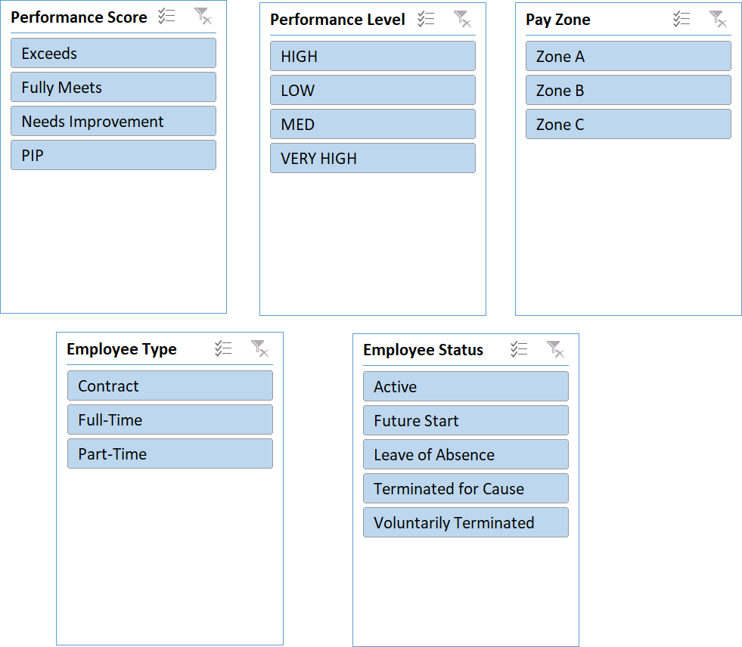
SLICER

Slide 15

RESULTS

Slide 16
RESULTS

Slide 17
RESULTS

Slide 18
RESULTS

Slide 19
conclusion
To conclude, Excel provides a practical, efficient, and adaptable solution for optimizing employee performance management.
By making performance data more accessible and actionable, it enhances workforce productivity and supports the development of a motivated, goal-oriented team.
Implementing an Excel-based performance analysis system is a smart approach for organizations aiming to enhance workforce management.
The system’s flexibility, cost-effectiveness, and scalability make it suitable for businesses of all sizes.
Moreover, by promoting transparency in performance measurement, it encourages accountability and motivation among employees.
This tool not only helps identify top performers and areas for improvement but also drives continuous growth and development, aligning employee efforts with organizational goals.

